Slide 1
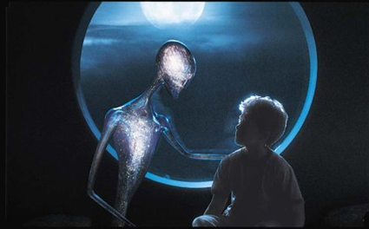
Introduction to Artificial Intelligence and Machine Learning

Slide 2
Textbooks
None!
Recommended References:
Machine Learning by Tom Mitchell
Pattern Recognition and Machine Learning by C.Bishop
Artificial intelligence: A modern Approach by Russell and Norvig

Slide 3
Outline
Unit 1 – Introduction to Artificial Intelligence and Machine Learning
Unit 2 – Data Preprocessing Techniques
Unit 3 – Logical and Reasoning Systems
Unit 4 – K-Nearest Neighbor Algorithm
Unit 5 – Linear Regression Algorithms
Unit 6 – Gradient Descent Algorithms
Unit 7 – Logistic Regression
Unit 8 – Graphical Models
Unit 9 -- Naïve Bayes Classifier

Slide 4
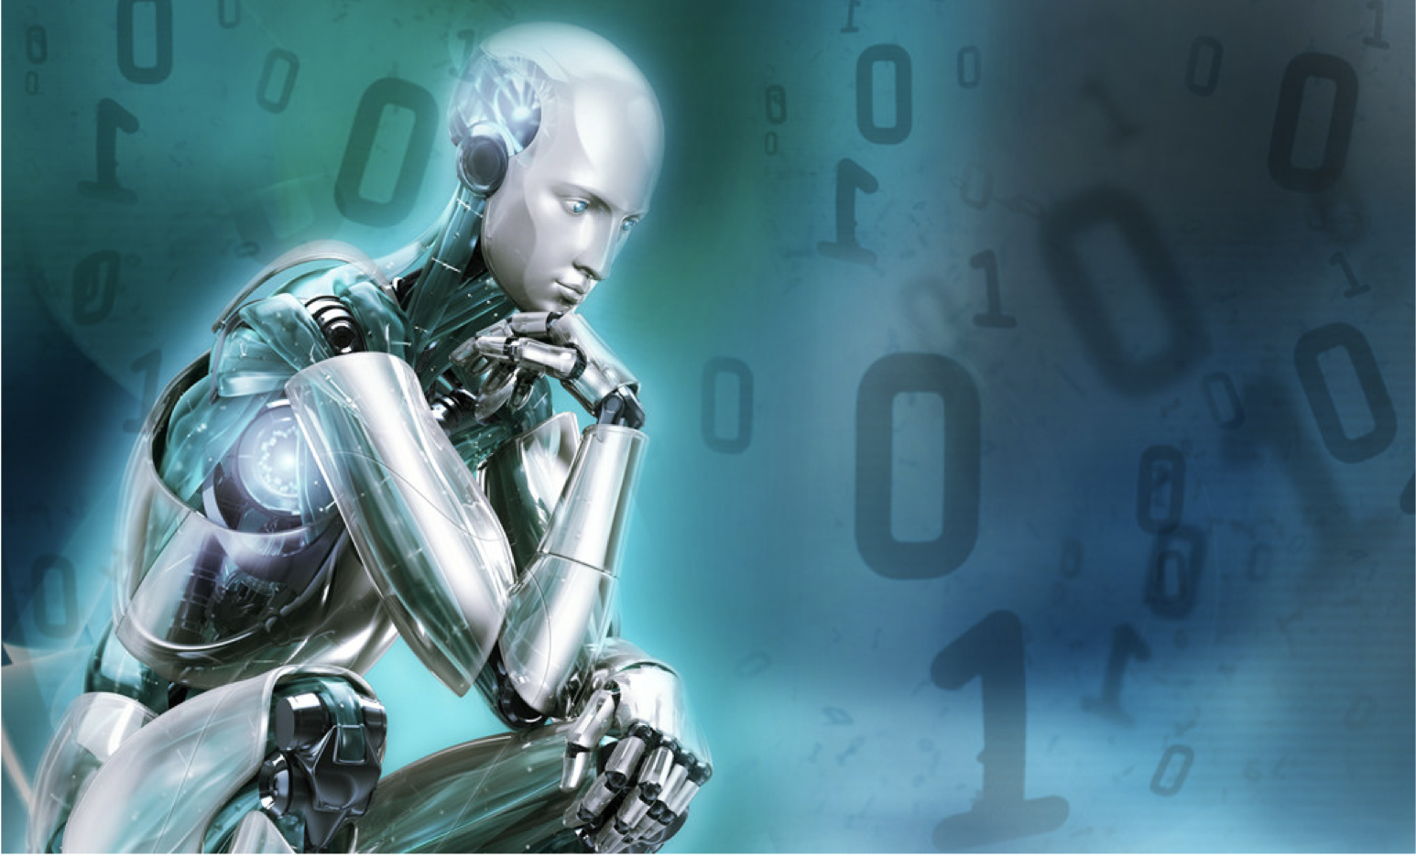
What is "AI"?

Slide 5
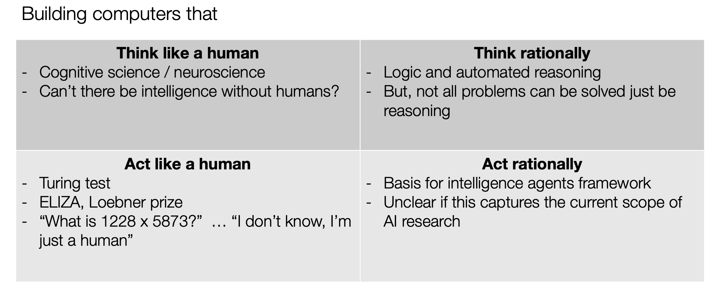
Some classic definitions

Slide 6
The Pragmatist’s View
“AI is that which appears in academic conferences on AI”
(Let’s ignore the possibility of "AI" from other sources)

Slide 7
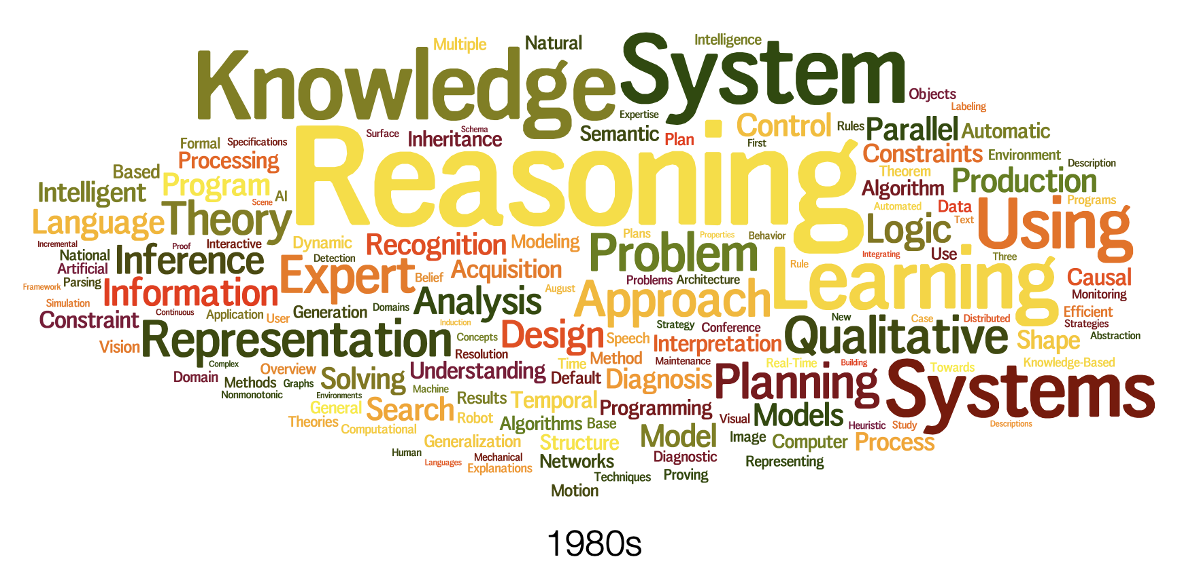
Paper Titles in AAAI

Slide 8
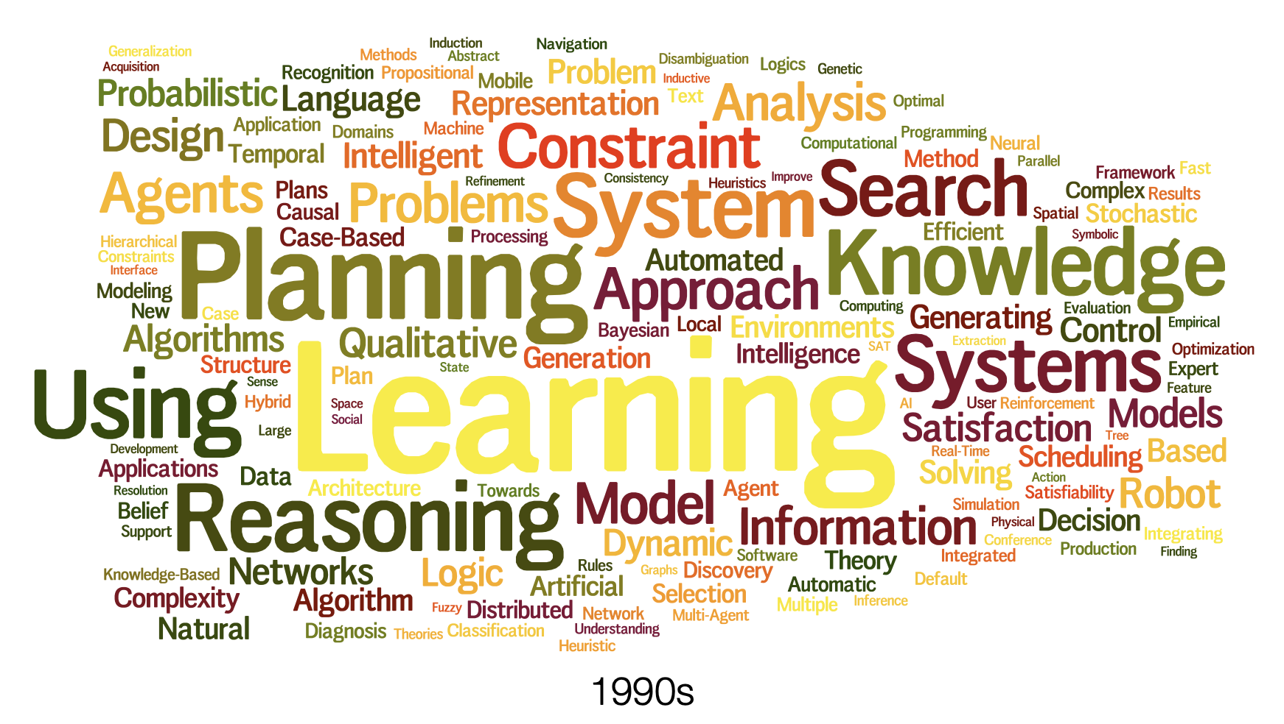
Paper Titles in AAAI cont...

Slide 9
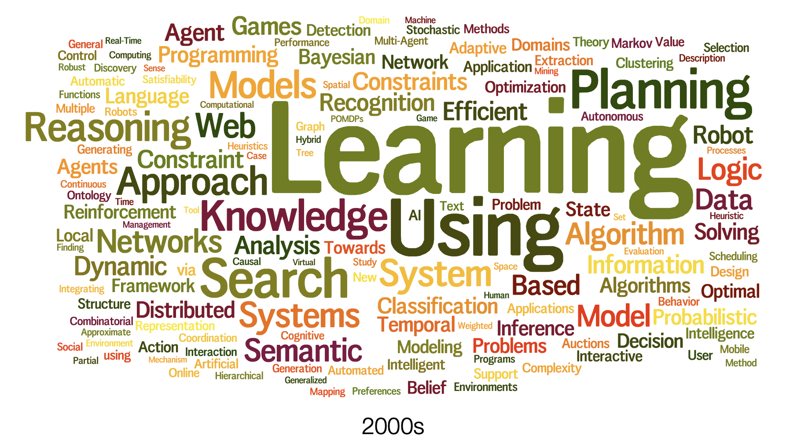
Paper Titles in AAAI cont...

Slide 10
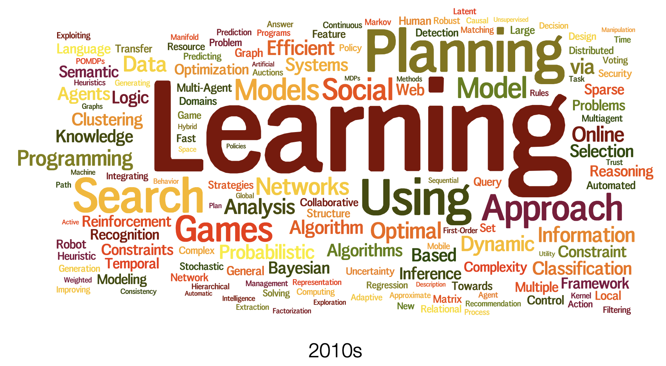
Paper Titles in AAAI cont...

Slide 11
A Broader Definition
We won’t worry too much about definitions. One explanation could be this one:
Artificial intelligence is the development and study of computer systems to address problems typically associated with some form of intelligence

Slide 12
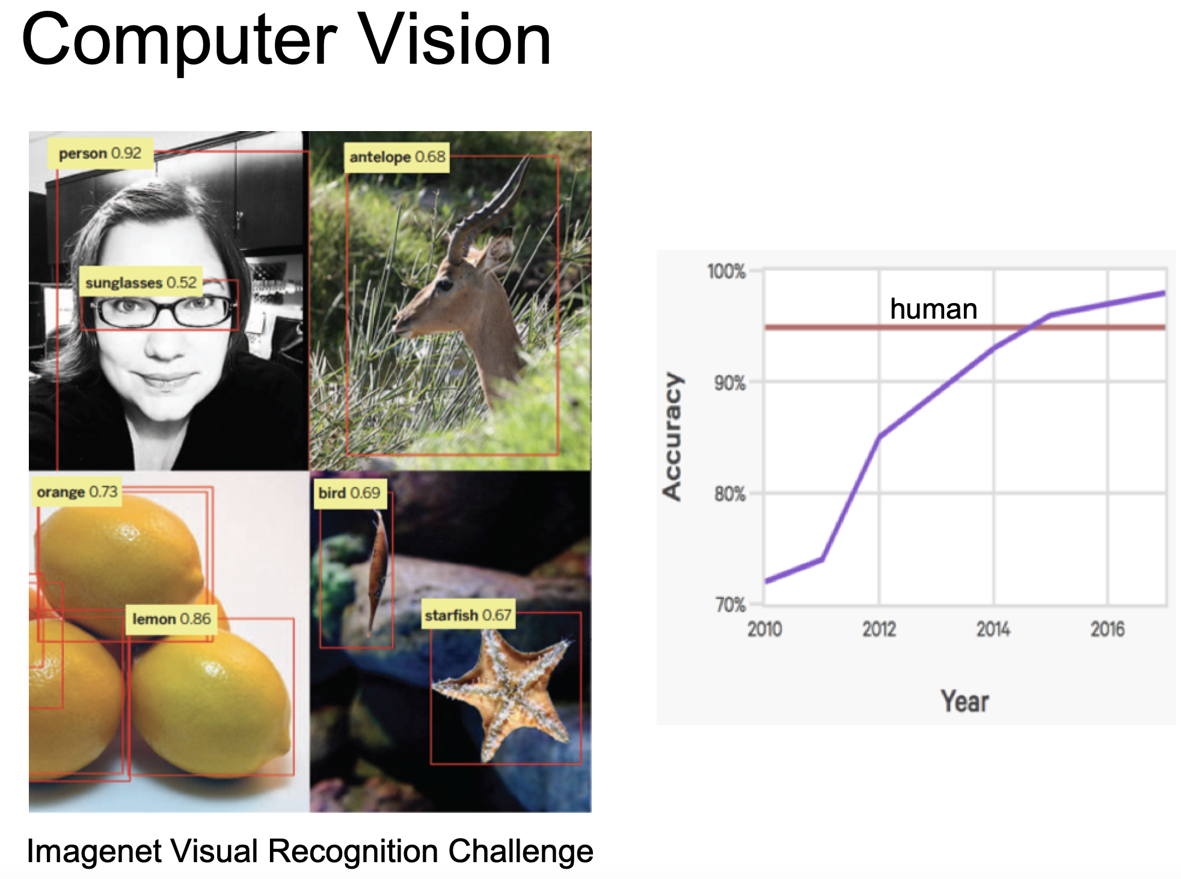

Slide 13
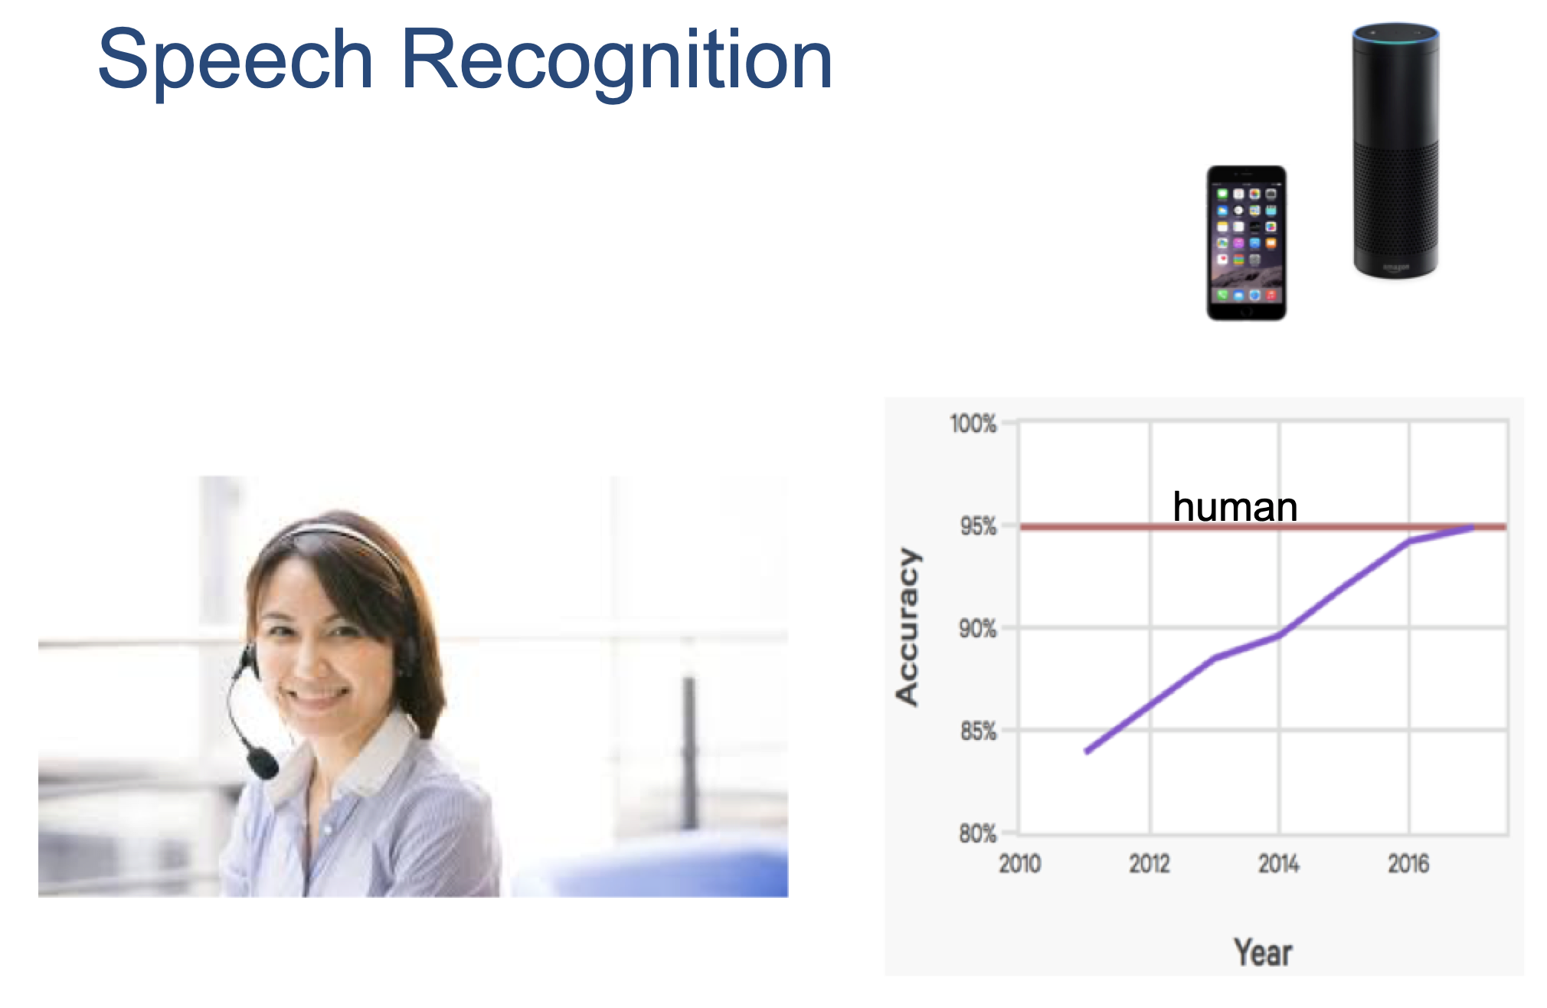

Slide 14
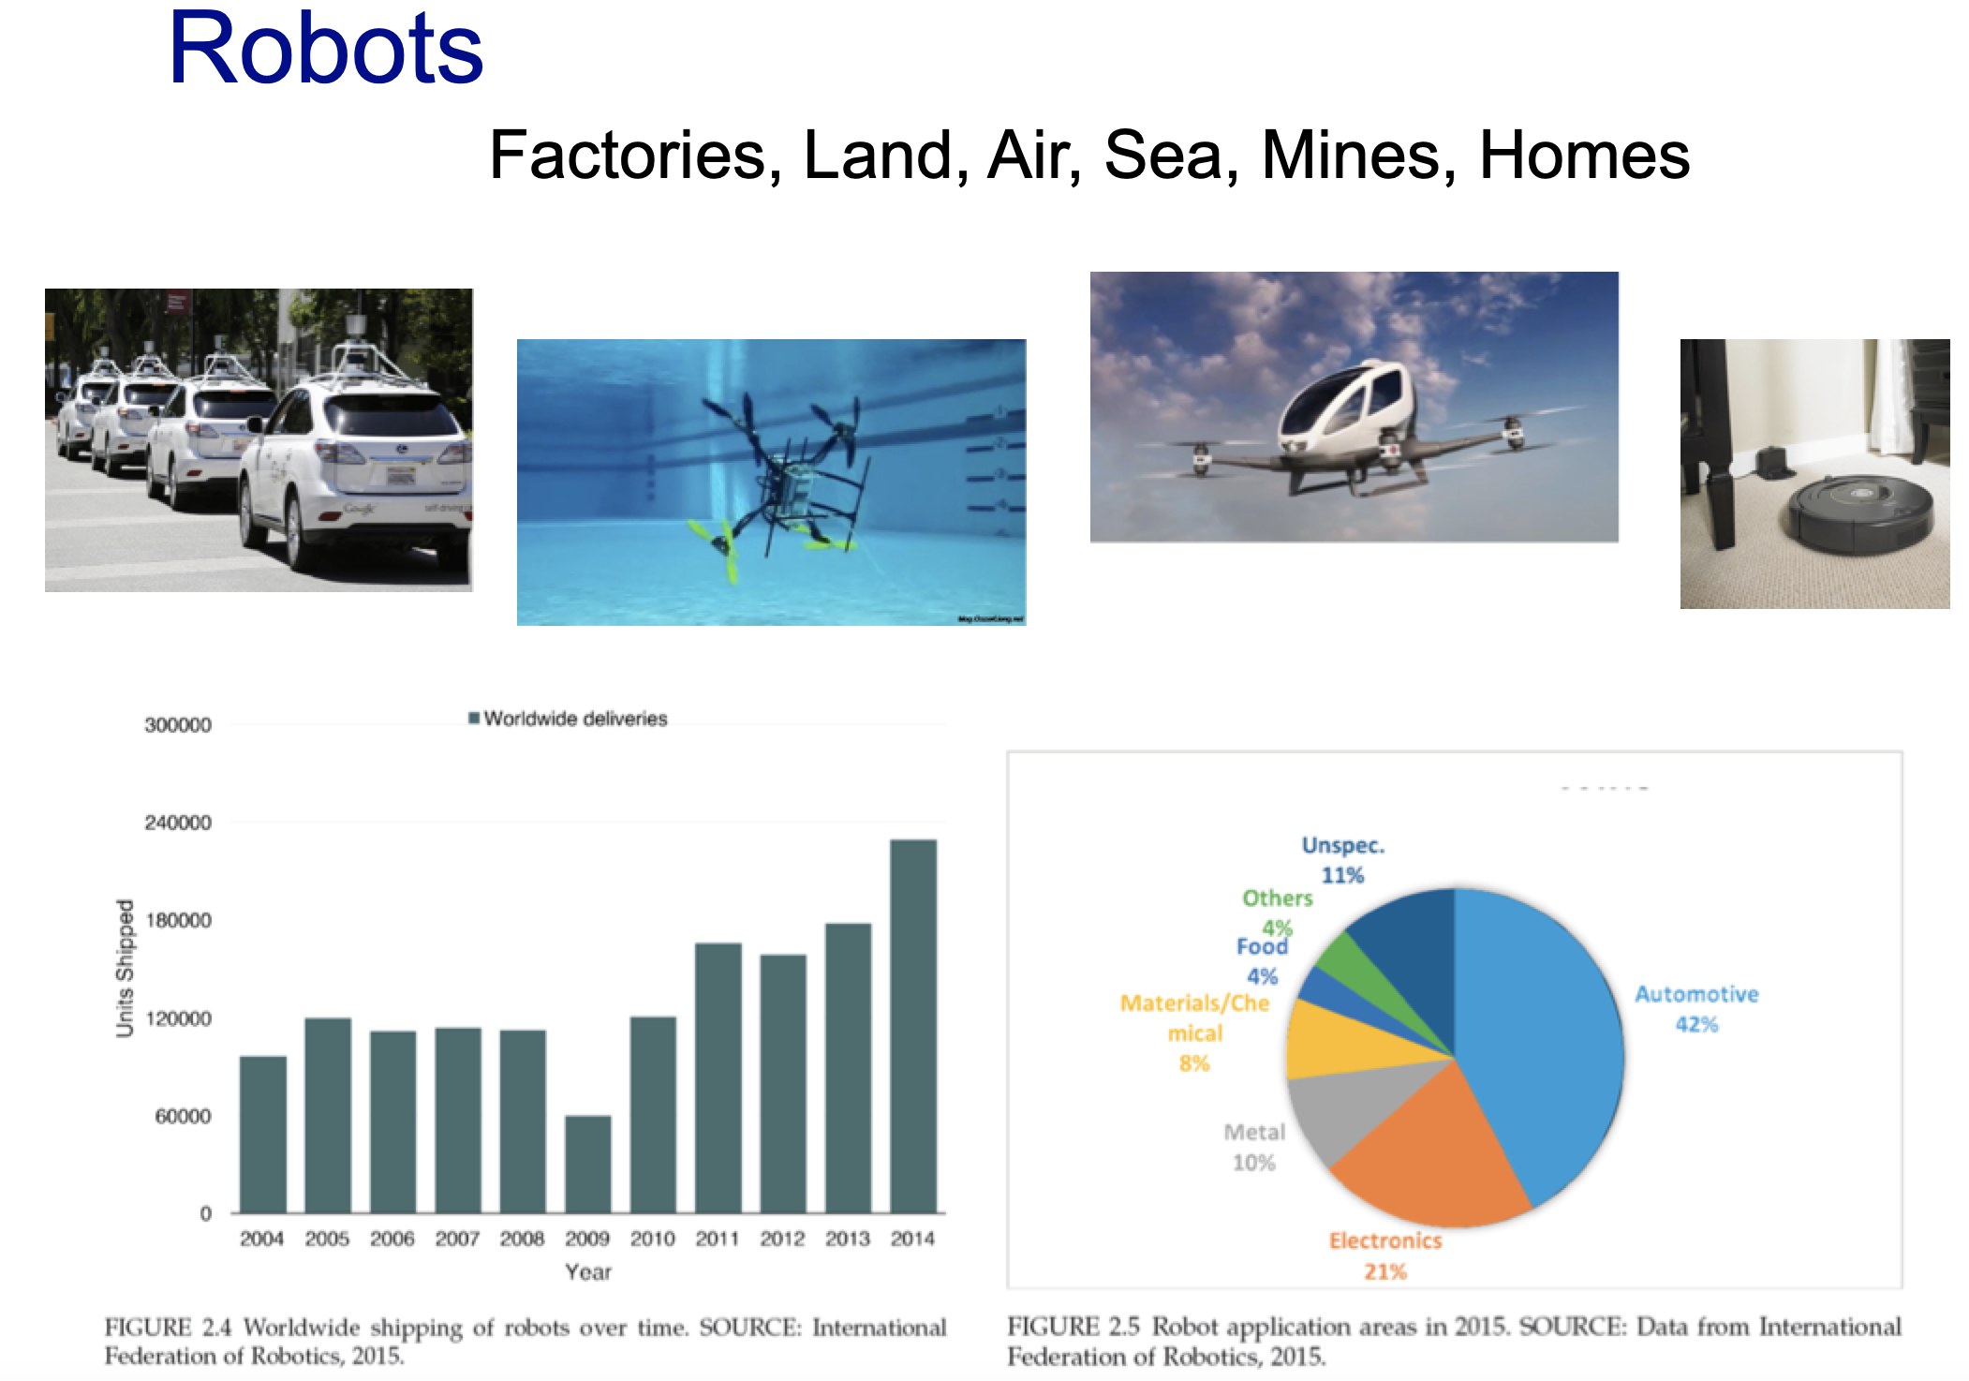

Slide 15
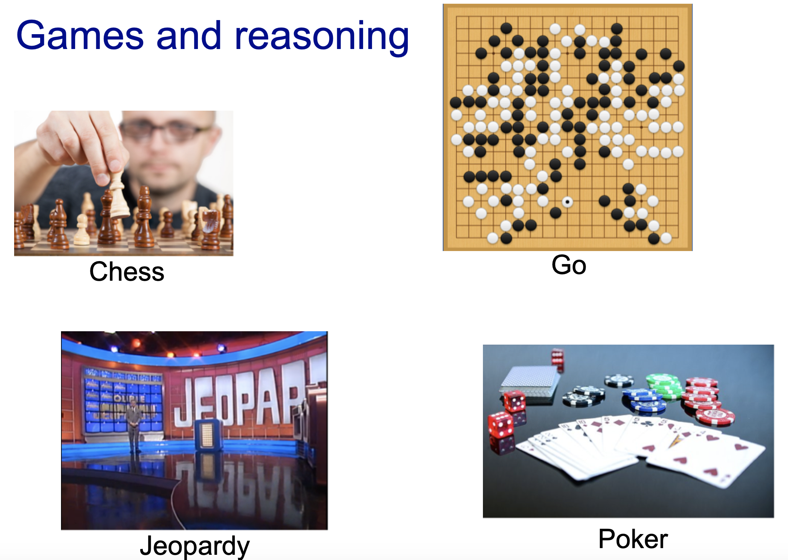

Slide 16
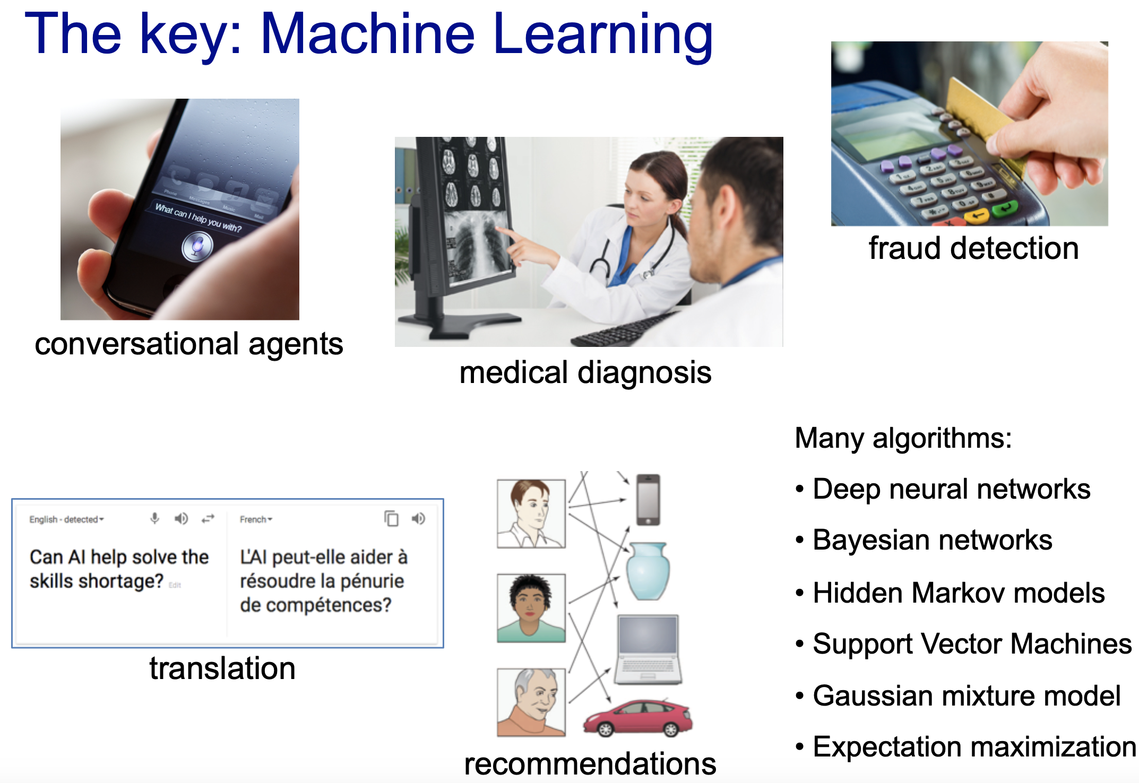

Slide 17
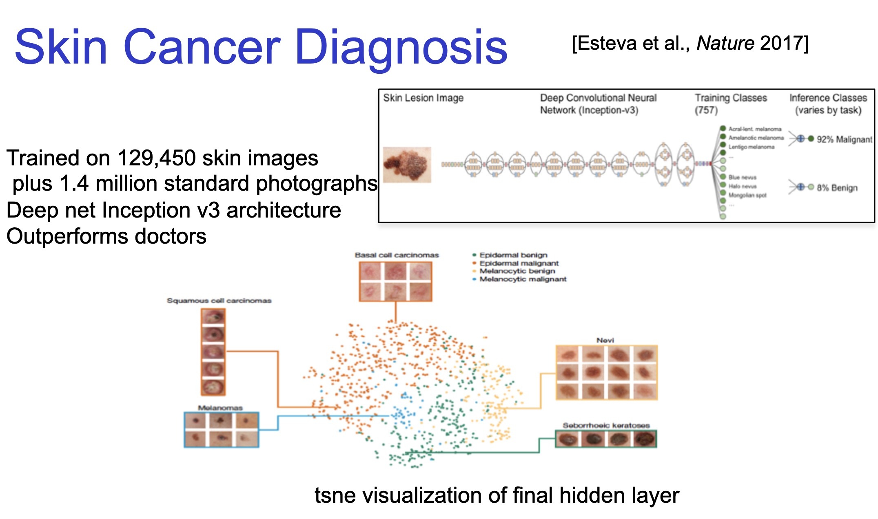

Slide 18
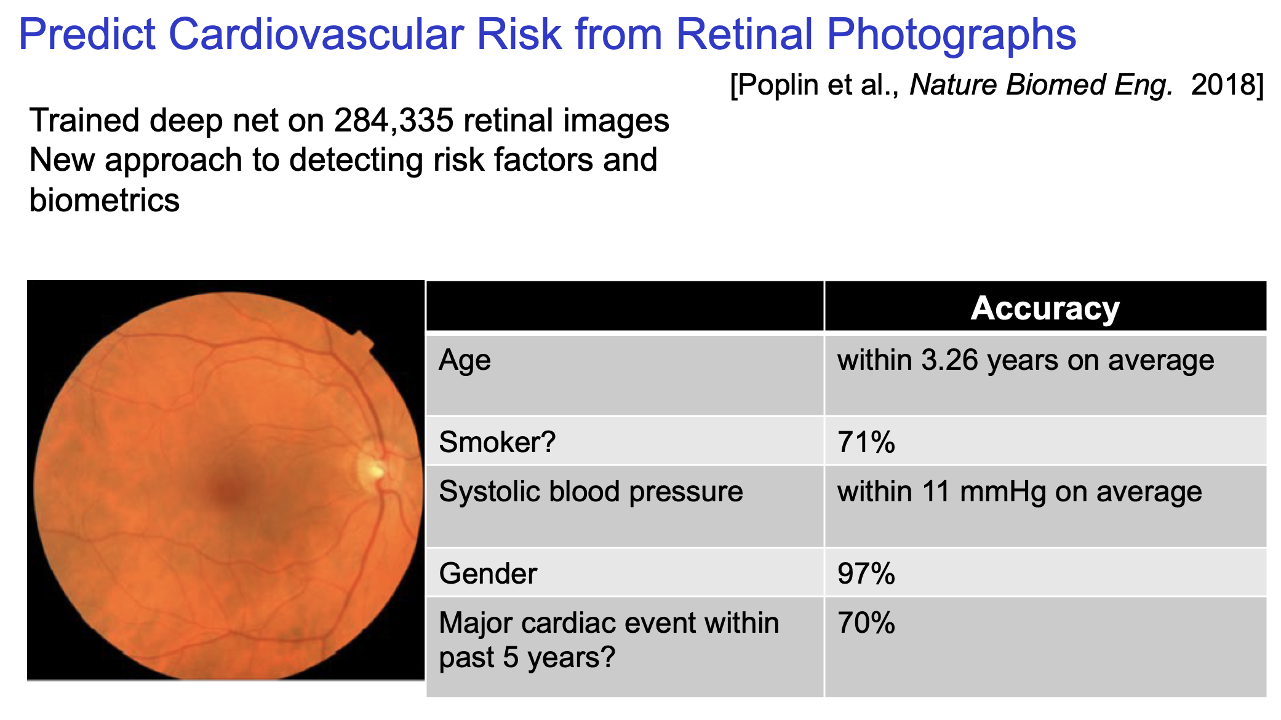

Slide 19
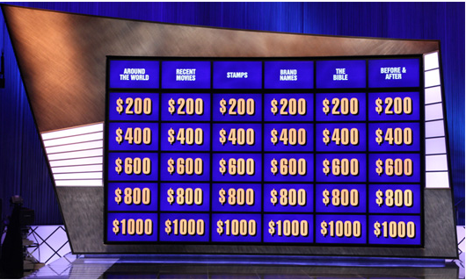
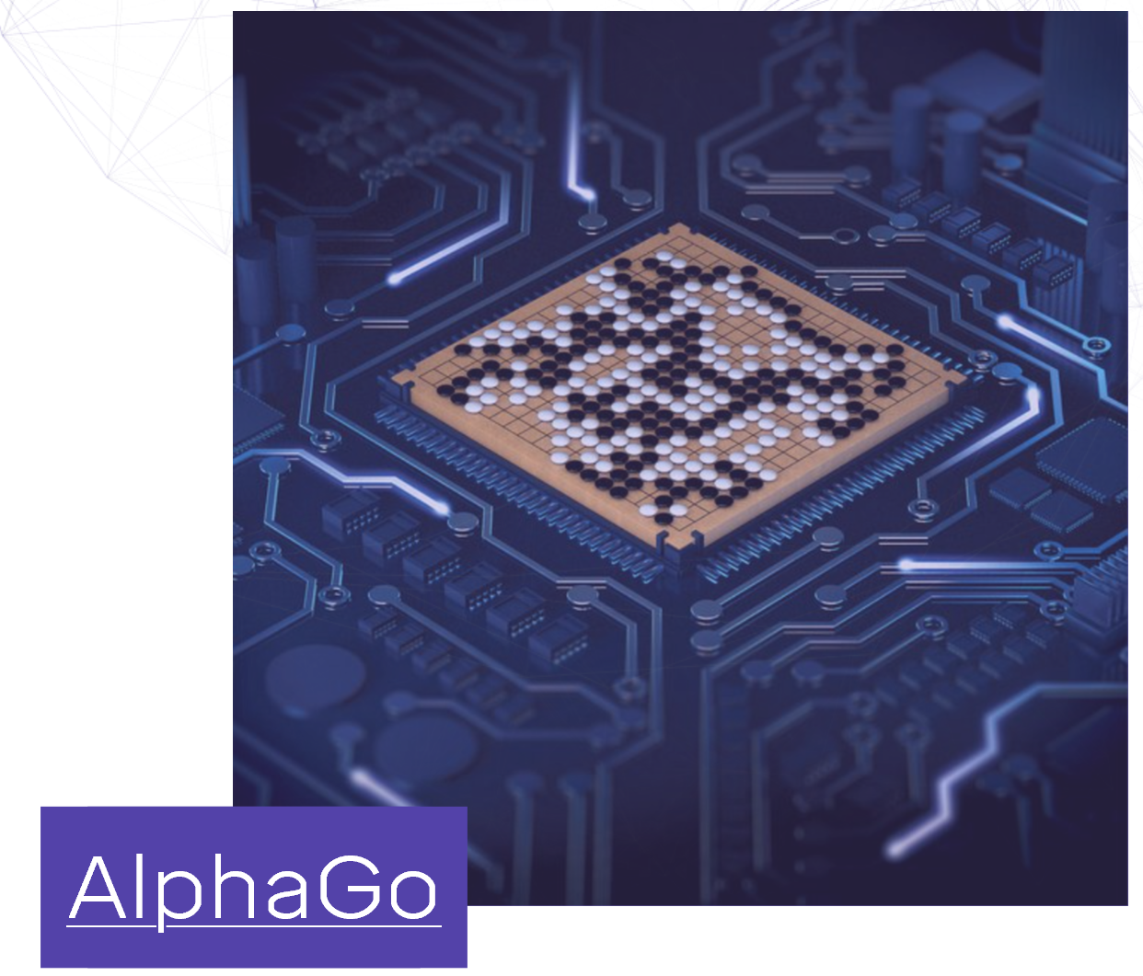
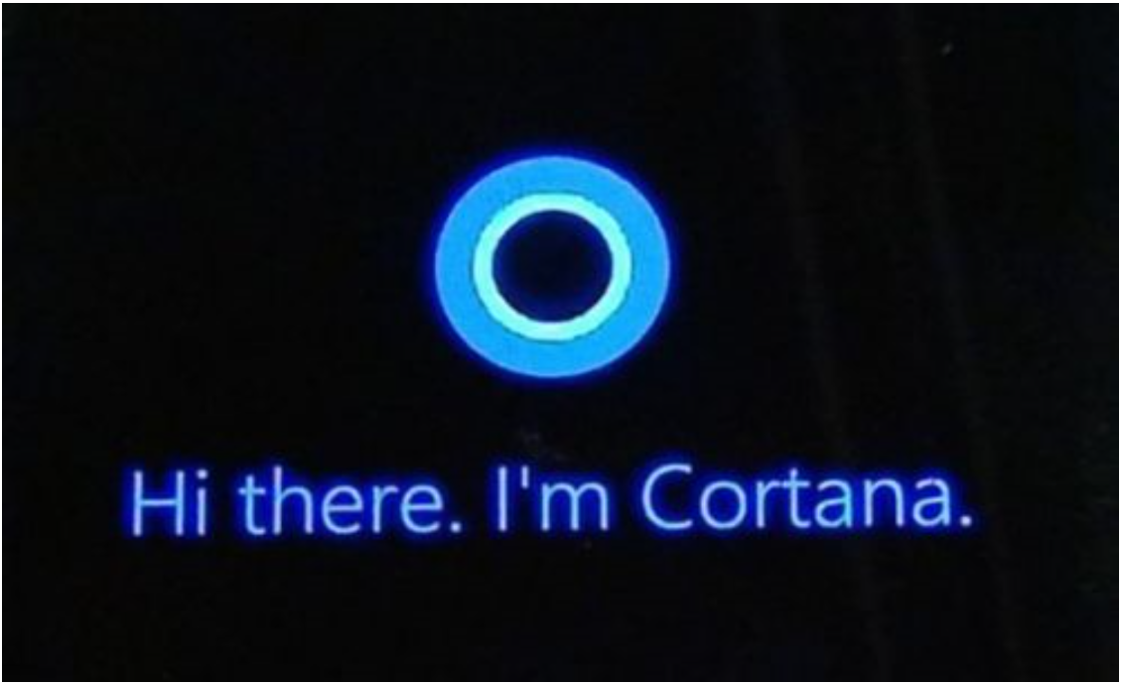
Waston
IBM
AlphaGo
Google Deepmind
Cortana, Siri, Google Now

Slide 20
Traditional Programming - sorting
design
a sorting problem: find a fast way
code
Implement the sorting algorithm
exe
Input, execute instruction then output

Slide 21
Machine learning - sorting
data
Preparing labeled data set like:
[1 2 3] labeled with ‘perfect’
learn
To learn a model from the data set by running a learning algorithm (coded by human beings)
test
When given a new array [ 3 4 1] the machine will output [1 3 4] basing on the algorithm
Though the sorting is not a typical problem of machine learning, it shows an idea of
Machine learning: we tell it which one is the best(objective), and it achieves the goal somehow.

Slide 22
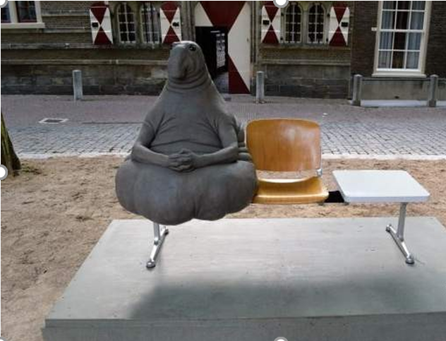
A real world problem – Will he/she be late?
Call him/her directly
Out of service
Learn from experience
5 times date with him
He was late one time, 80%
I believe that if it is less than 70%, he will be late this time
I assume that he won’t be late this time

Slide 23
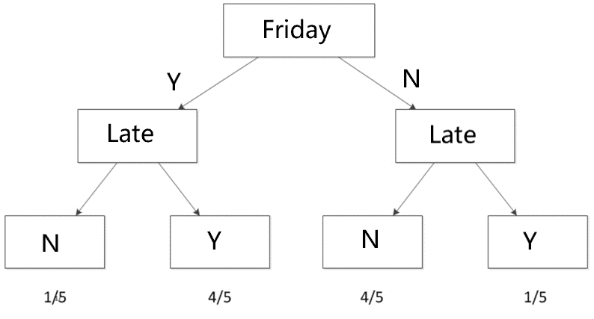
Learn from experience/data - induction
Let’s consider more info
Late? | Day of the week | Weather
Y | Friday | rain
Y | Friday | sunny
N | Thursday | cloudy
…….

Slide 24
Machine learning way
If we consider more info: holiday, the traffic, …
A more complicate model should be learned
Let the computer has the ability of
Step 1: learning from experience/data and creating a computational model
Step 2: Using this model to make decision(predict/recognize/classify)

Slide 25
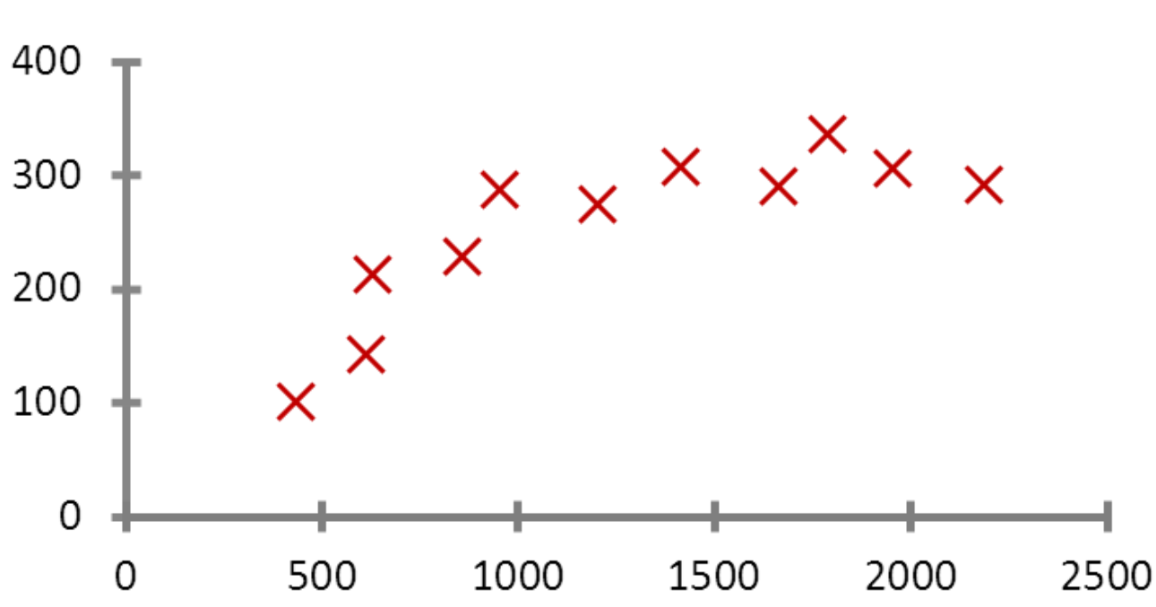
Price of house
I have a house with size of 1,000 Sqft
Estimate the price
Compare it with the houses in my neighborhood
Collect 11 houses the area + price
Is there a pattern/model in them?
price
Straight line: price = A * area + B
……
A, B are coefficients/parameters
area
Notes:
Linear model

Slide 26
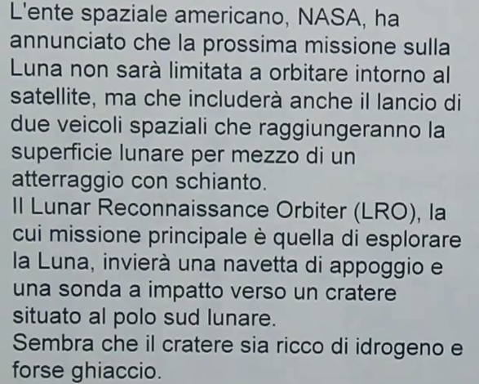
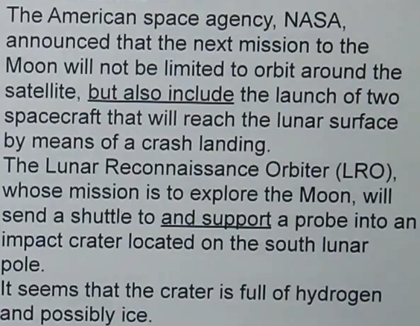
A Translation System without dictionary
Italian
English
Notes:
20 languages in the system, large amount of essays written in at least 2 languages. Machine learn to translate via learning – e.g. American – americano etc.

Slide 27
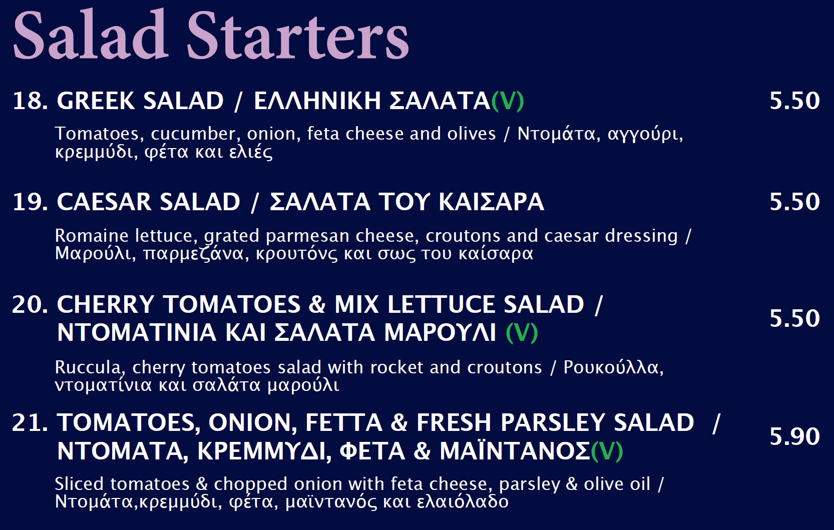

English - Greek

Slide 28
 | English | Greek
18 | GREEK SALAD | ΕΛΛΗΝΙΚΗ ΣΑΛΑΤΑ
19 | CAESAR SALAD | ΣΑΛΑΤΑ ΤΟΥ ΚΑΙΣΑΡΑ
20 | CHERRY TOMATOES MIX LETTUCE SALAD | ΝΤΟΜΑΤΙΝΙΑ ΚΑΙ ΣΑΛΑΤΑ ΜΑΡΟΥΛΙ
21 | TOMATOES ONION FETTA FRESH PARSLEY SALAD | ΝΤΟΜΑΤΑ, ΚΡΕΜΜΥΔΙ, ΦΕΤΑ & ΜΑΪΝΤΑΝΟΣ

Slide 29
 | English | Greek
46 | GRILLED CHICKEN BREAST | ΚΟΤΟΠΟΥΛΟ ΣΤΗ ΣΧΑΡΑ
46 | Succulent chicken breast grilled to perfection | Στήθος στη σχάρα με μπαχαρικά
45 | Succulent chicken breast grilled with our special seasoning topped with melted cheese & sauté onions & mushrooms | Στήθος στη σχάρα με μπαχαρικά, τυρί, κρεμμύδια & μανιτάρια
Training
Candidate words Corresponding to GRILLED | Occurrences
ΚΟΤΟΠΟΥΛΟ | 1
ΣΤΗ | 3
ΣΧΑΡΑ | 3
Στήθος | 2
Με | 2
Μπαχαρικά | 2
Τυρί | 1
Κρεμμύδια | 1
Μανιτάρια | 1
Grilled
στη σχάρα
Testing

Slide 30
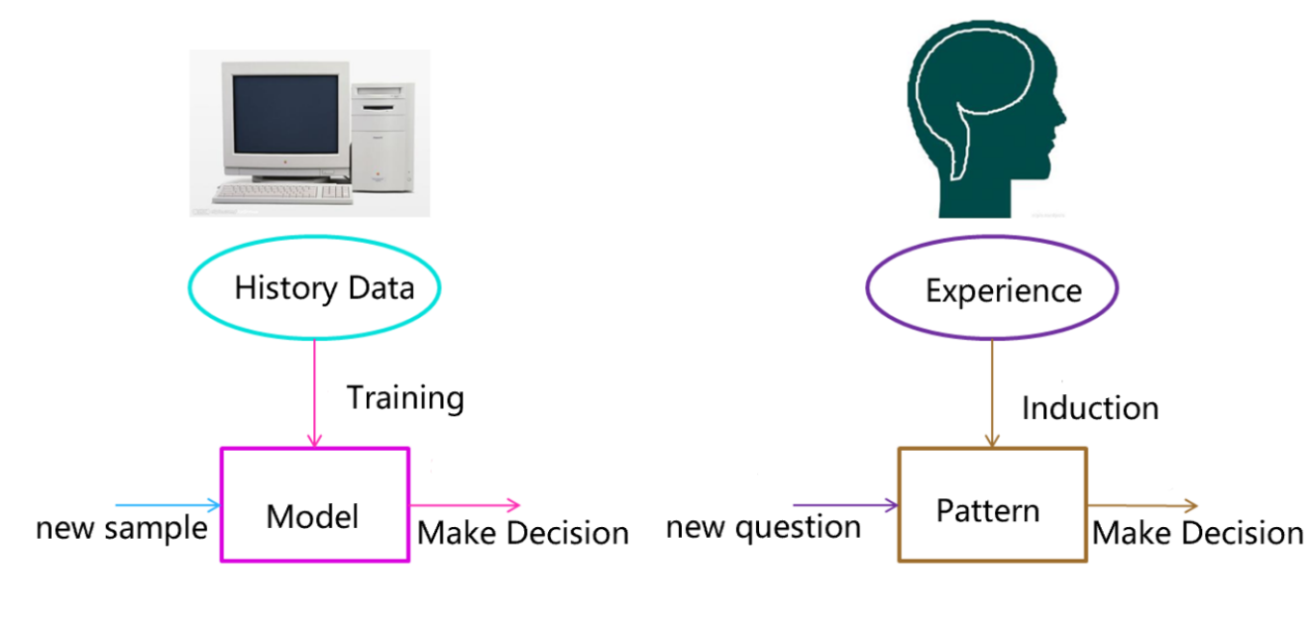
Machine vs. human
The form of the model should be given in advance
Different forms can by apply: straight line, curve ….
More data help the model considering different situations, thus make the model more generative

Slide 31
Scope
Machine Learning

Slide 32
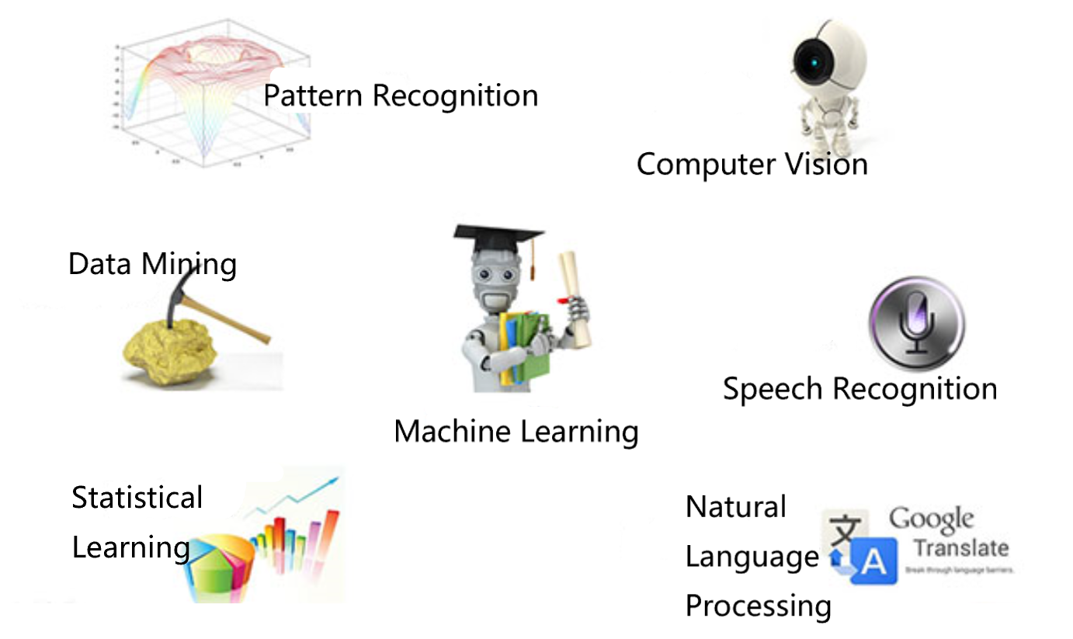

Slide 33
Machine learning = Pattern Recognition
Pattern recognition has its origins in engineering, whereas machine learning grew out of computer science. However, these activities can be viewed as two facets of the same field, and together they have undergone substantial development over the past ten year.
---- Bishop《 Pattern Recognition And Machine Learning》

Slide 34
Statistical learning ≈ Machine learning
Statistical learning is an area which is highly overlapped with machine learning.
Most machine learning methods are from statistical learning.
Clustering
The difference
Statistical learning focus on the development and optimization of statistical models
Machine learning focus on models applying

Slide 35
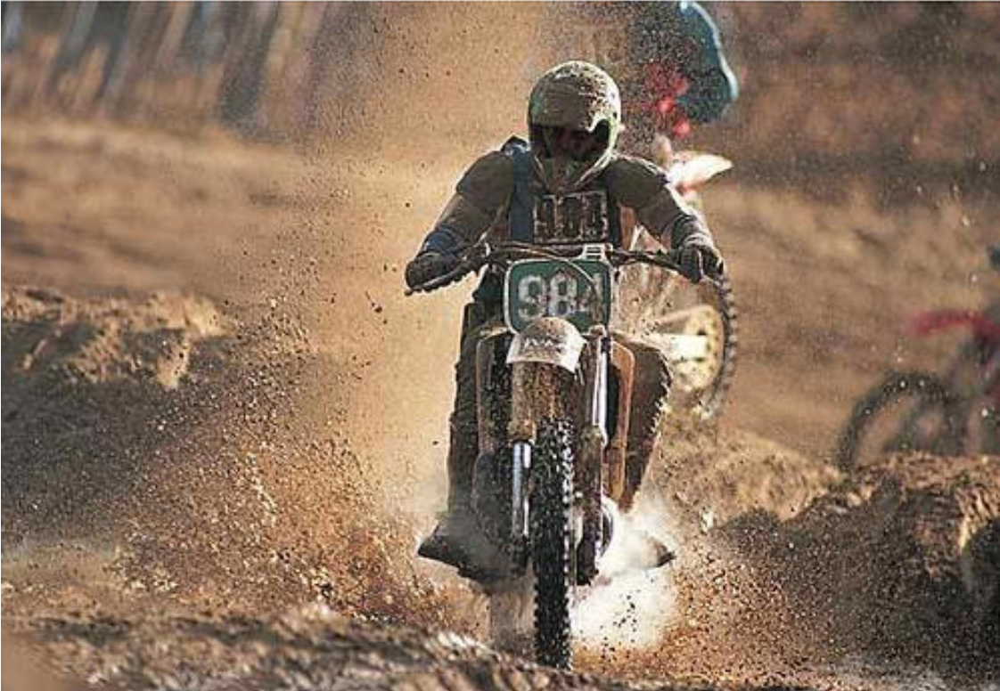
Computer Vision = Machine learning + Image Processing
Image or video means large amount of data (pixels)
Features are extracted from pixels to help improve the recognition efficiency and effective
Image processing is used in feature extraction
A person riding a motorcycle on a dirt road

Slide 36
Speech Recognition = Machine learning + Speech Processing + NLP
Similar to Computer Vision, features of audio signal first needs to be extracted and then feed to machine learning algorithm
The objective of introducing Natural Language Processing is to let machine really understand what we are speaking of. Study of Linguistics models could be helpful in this area.

Slide 37
Methods
Machine Learning

Slide 38
3 types of learning
Supervised
in which the training data is labelled with the correct answers.
Unsupervised
in which we are given a collection of unlabelled data, which we wish to analyse and discover patterns within.
Reinforcement
in which an agent seeks to learn the optimal actions to take basing on the reward of past actions.

Slide 39
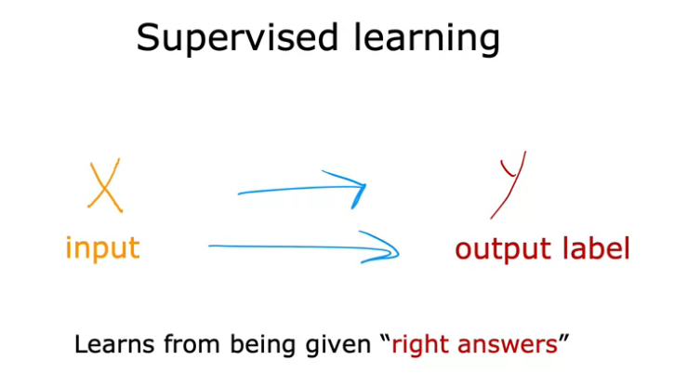
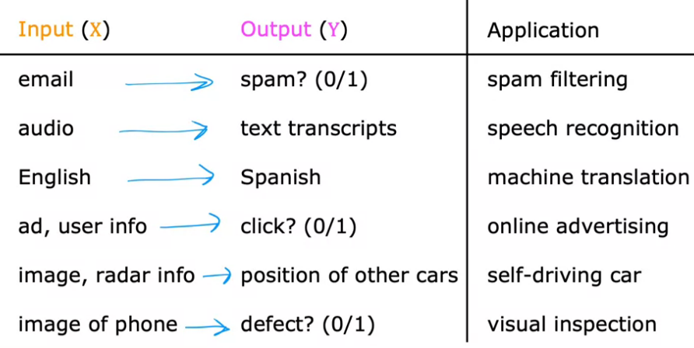
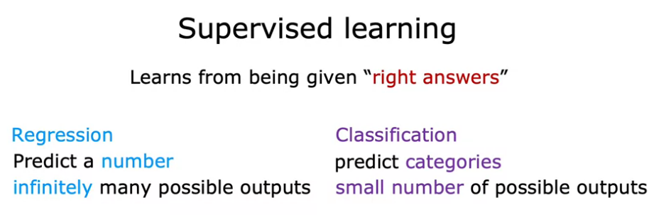
Supervised Learning

Slide 40
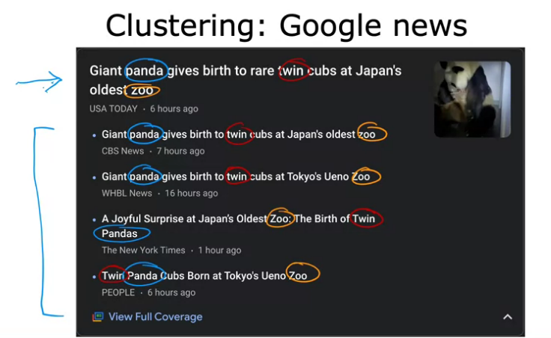
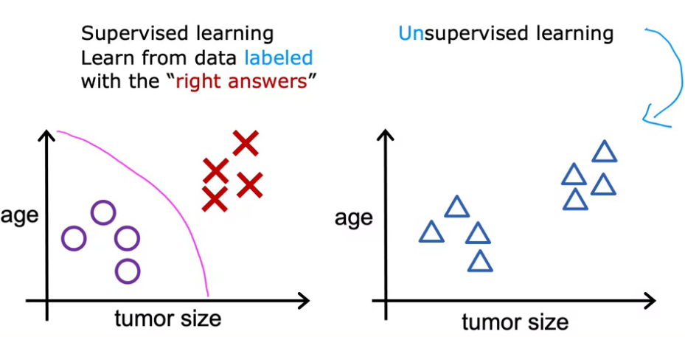
Unsupervised Learning
In unsupervised learning, we are not telling it
Any right answer, but letting it find some
patterns
In the above example, the clustering happens on its own
As no one guides Google on how clustering is to be done.

Slide 41
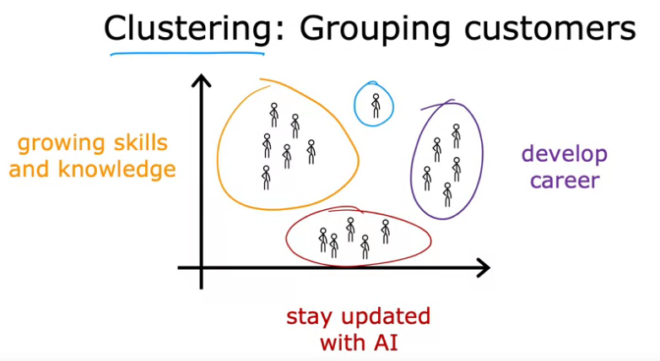
Clustering Algos

Slide 42
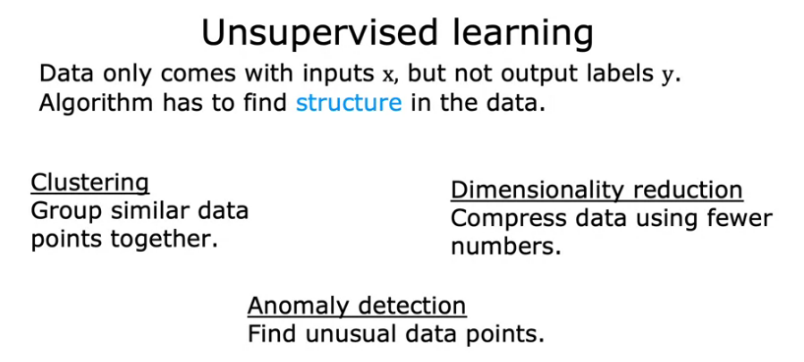
Other unsupervised Algos

Slide 43
Regression
price
area
supervised

Slide 44
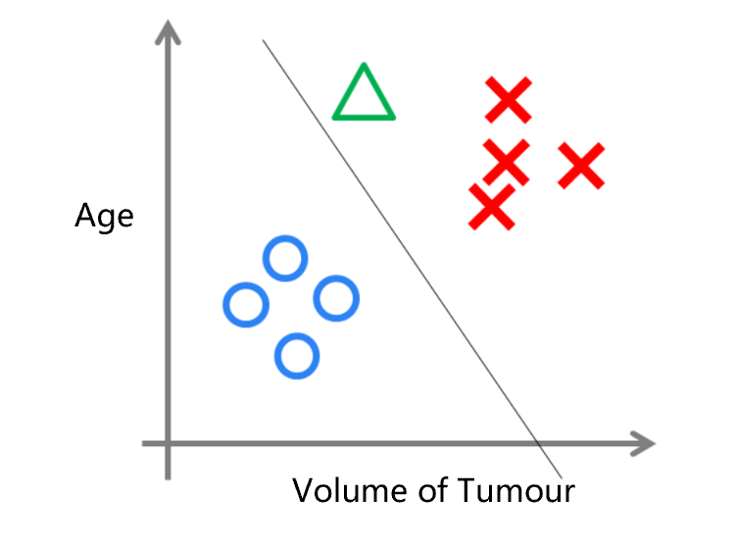
Logistic Regression
Data
Age of Patient Size of Tumour Benign/Cancer
supervised

Slide 45
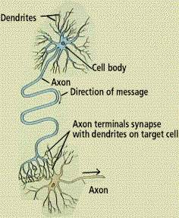
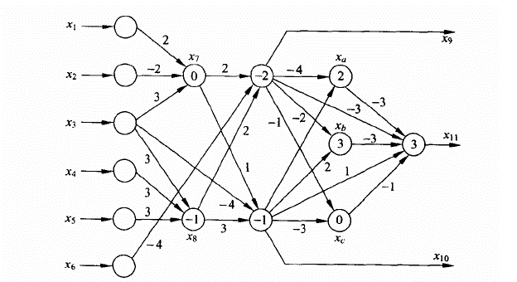
Neural Network
supervised

Slide 46

Neural Network - LeNet

Slide 47
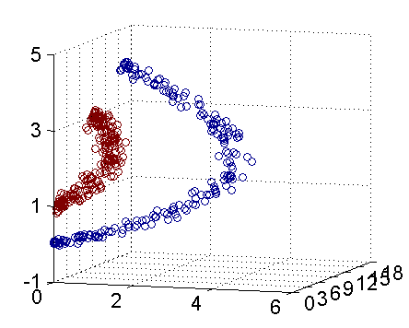
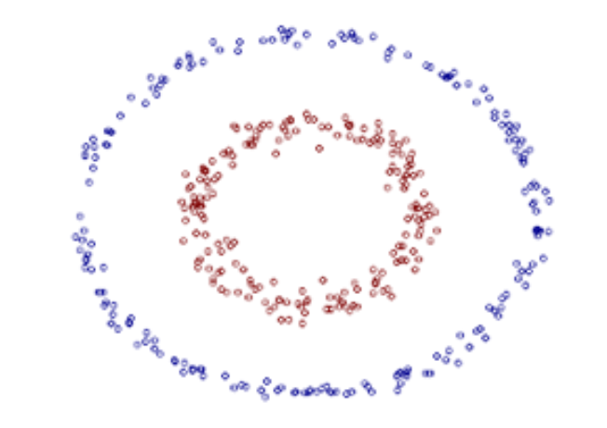
Support Vector Machine with kernel
2D → 3D
supervised

Slide 48
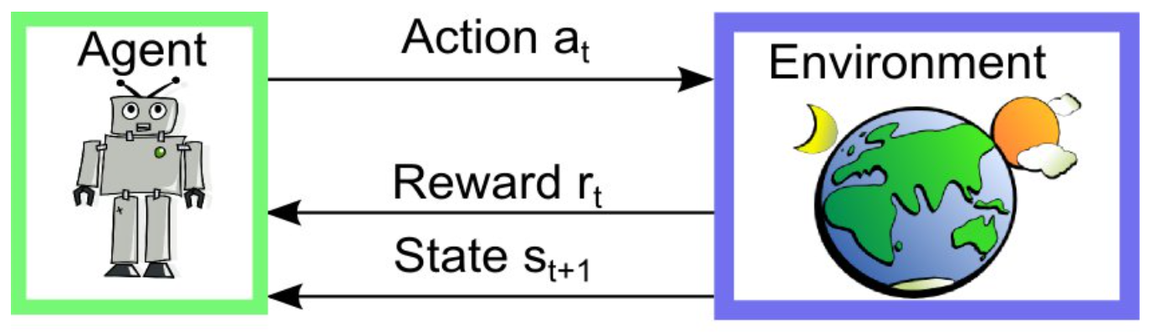
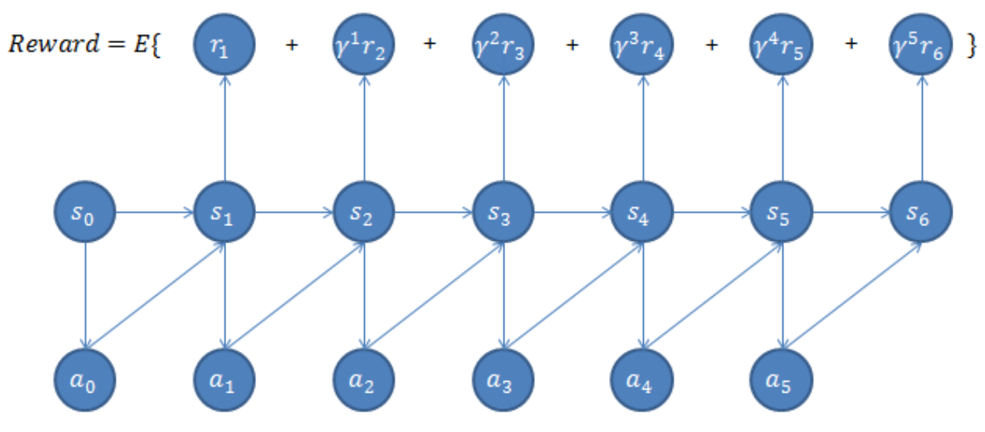
Reinforcement Learning

Slide 49
Others
Clustering – unsupervised learning
Bayes Network
Decision Tree
Recommendation algorithm
……

Slide 50
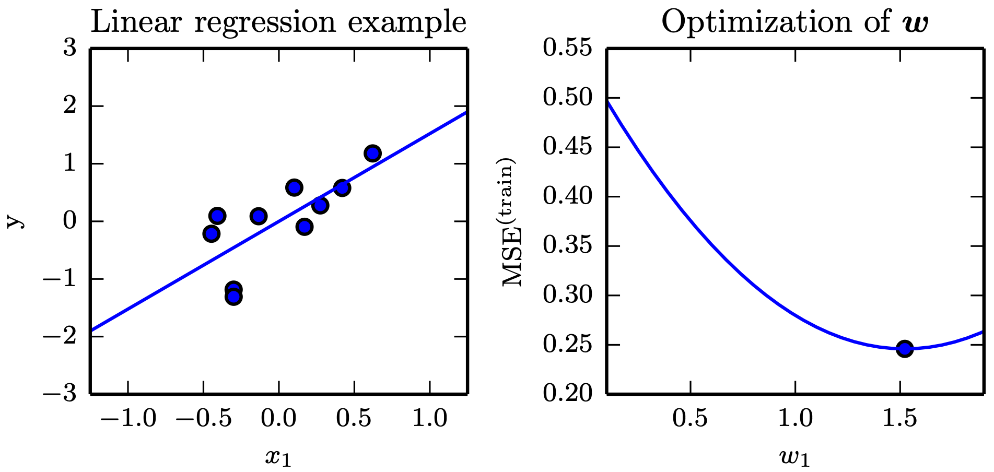
Linear Regression
Figure 5.1

Slide 51
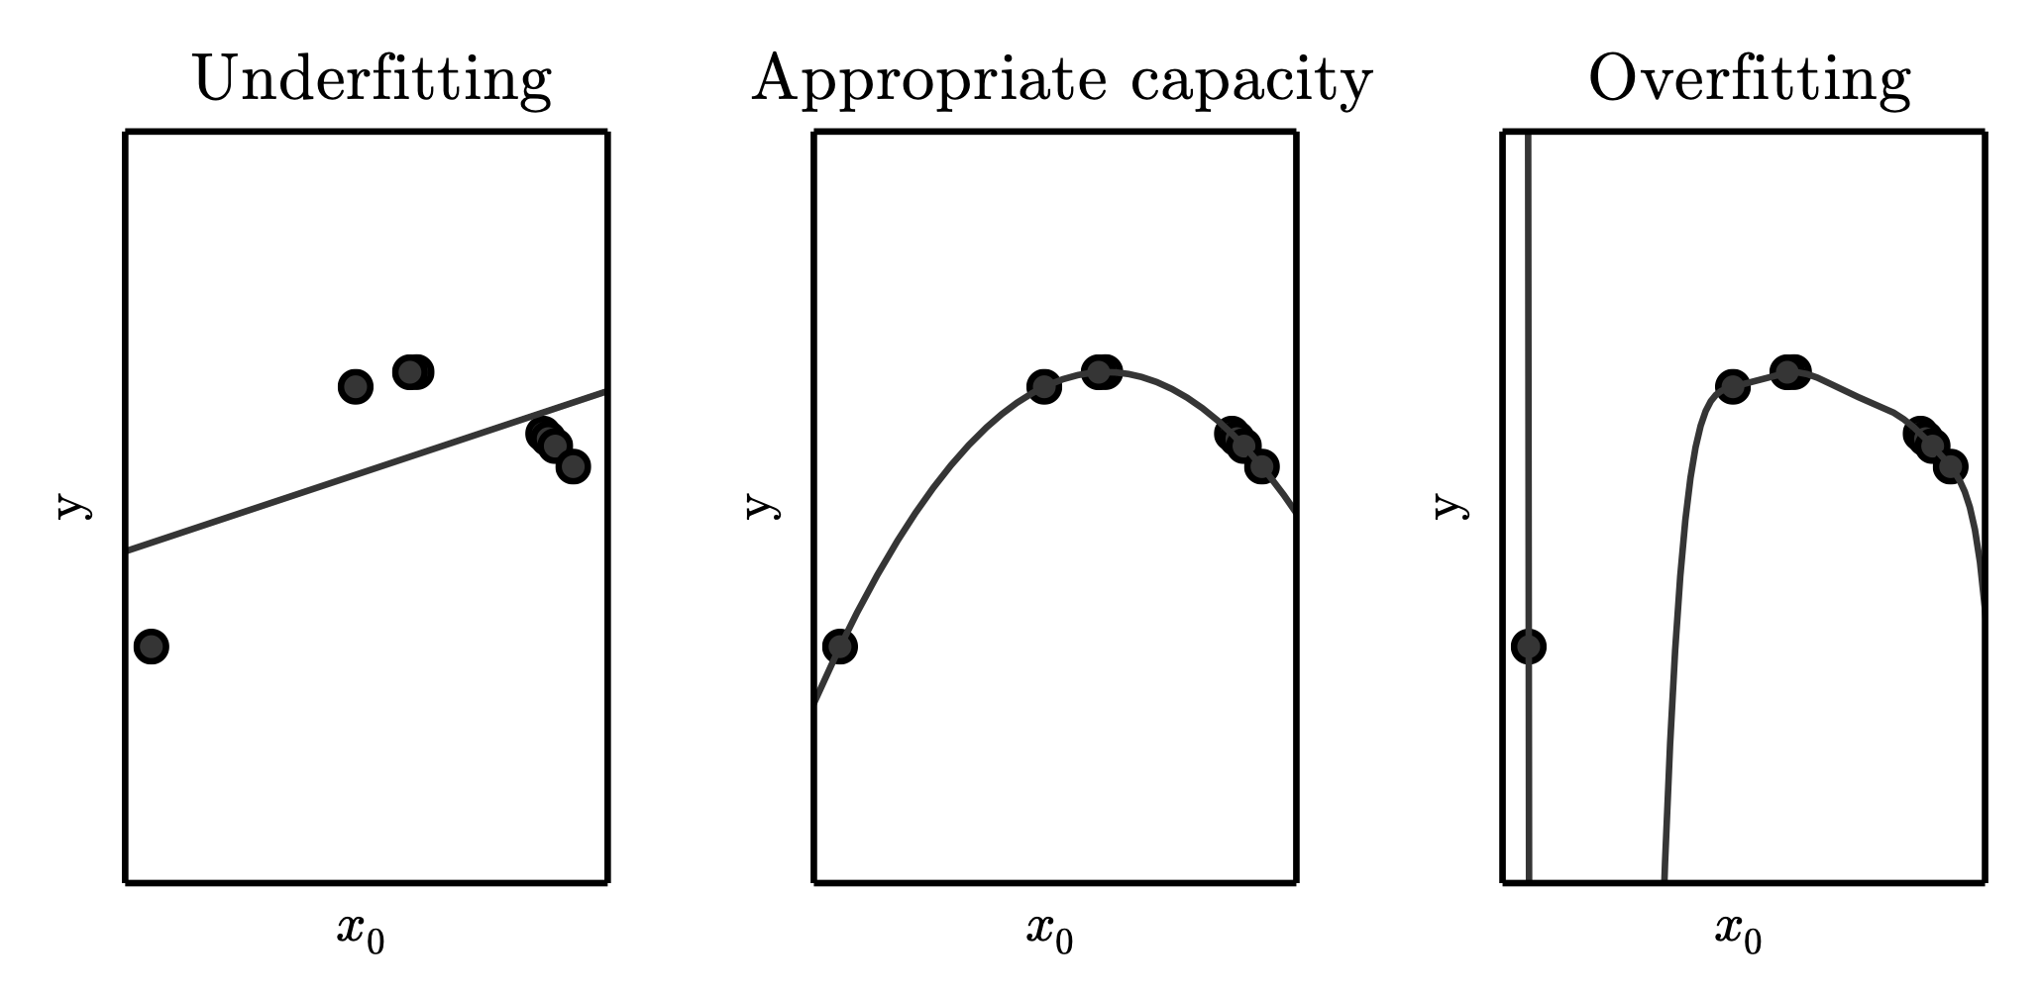
Underfitting and Overfitting in Polynomial Estimation
Figure 5.2

Slide 52
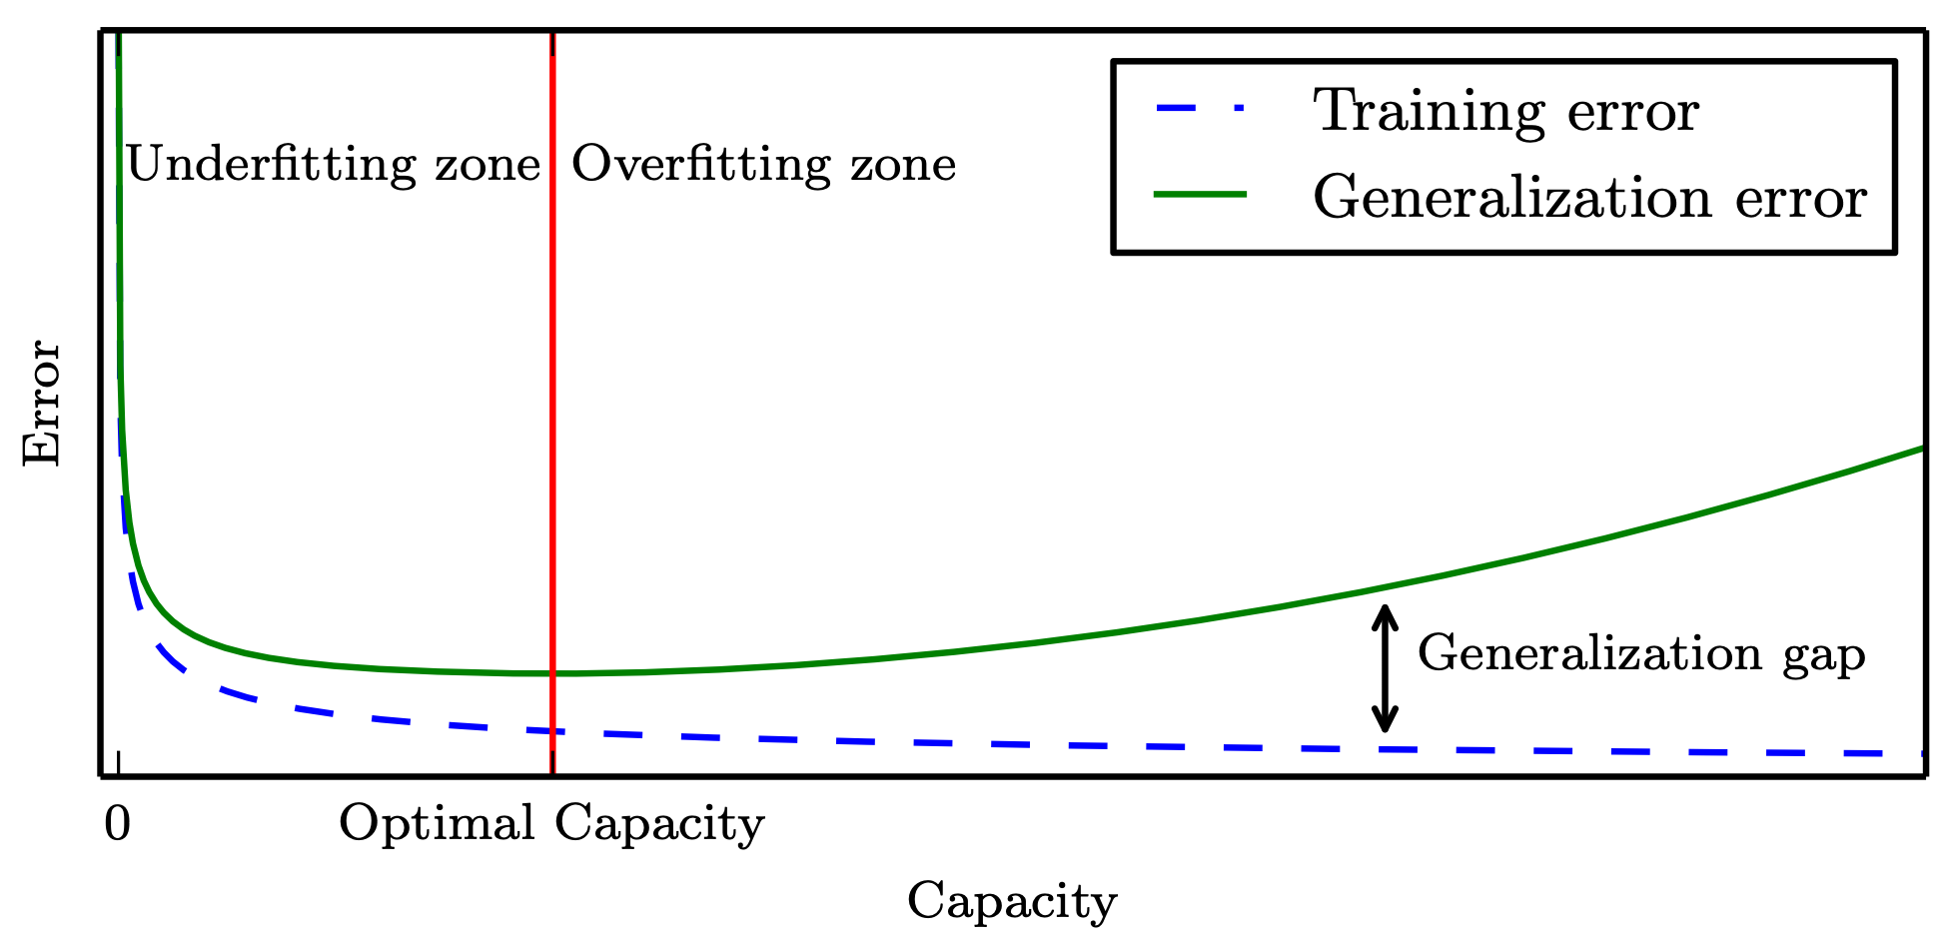
Generalization and Capacity
Figure 5.3

Slide 53
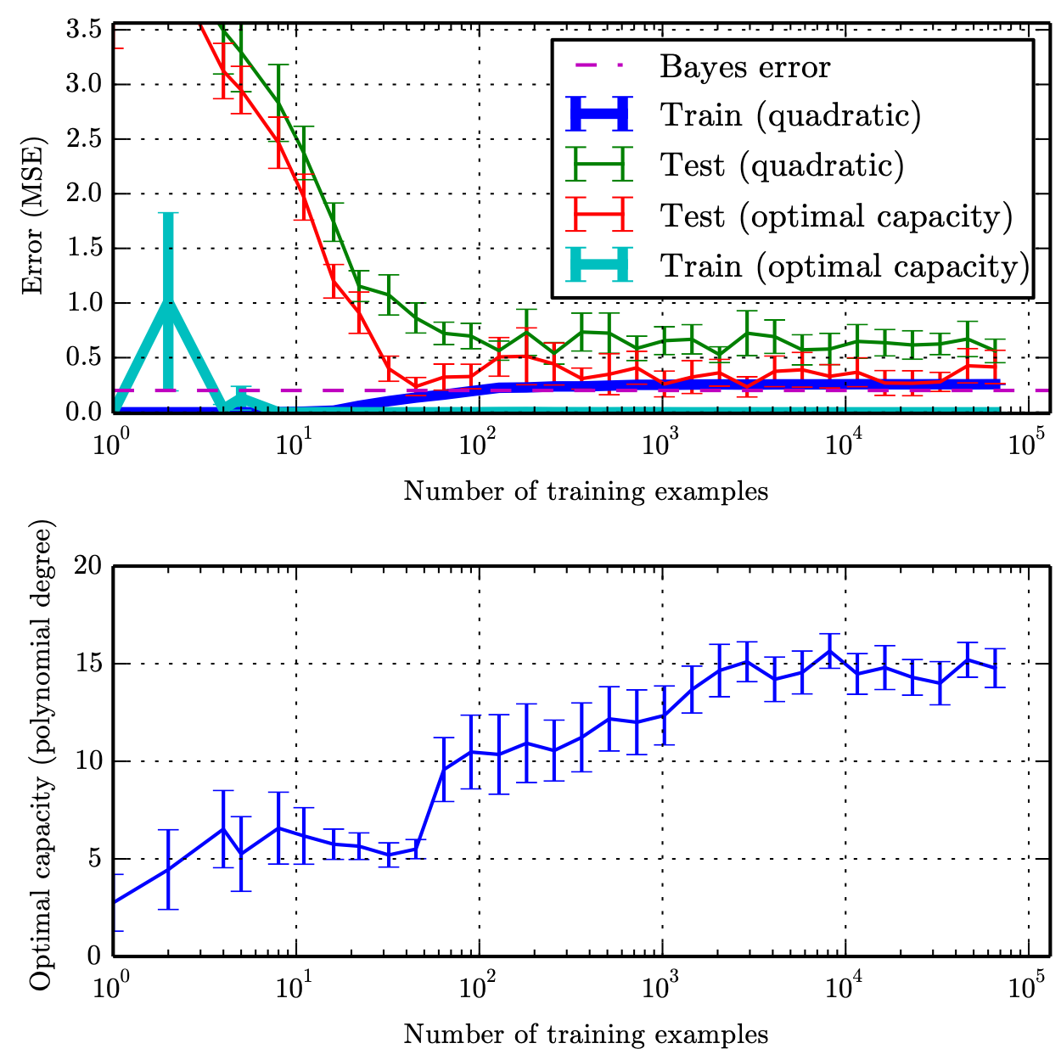
Training Set Size
Figure 5.4

Slide 54
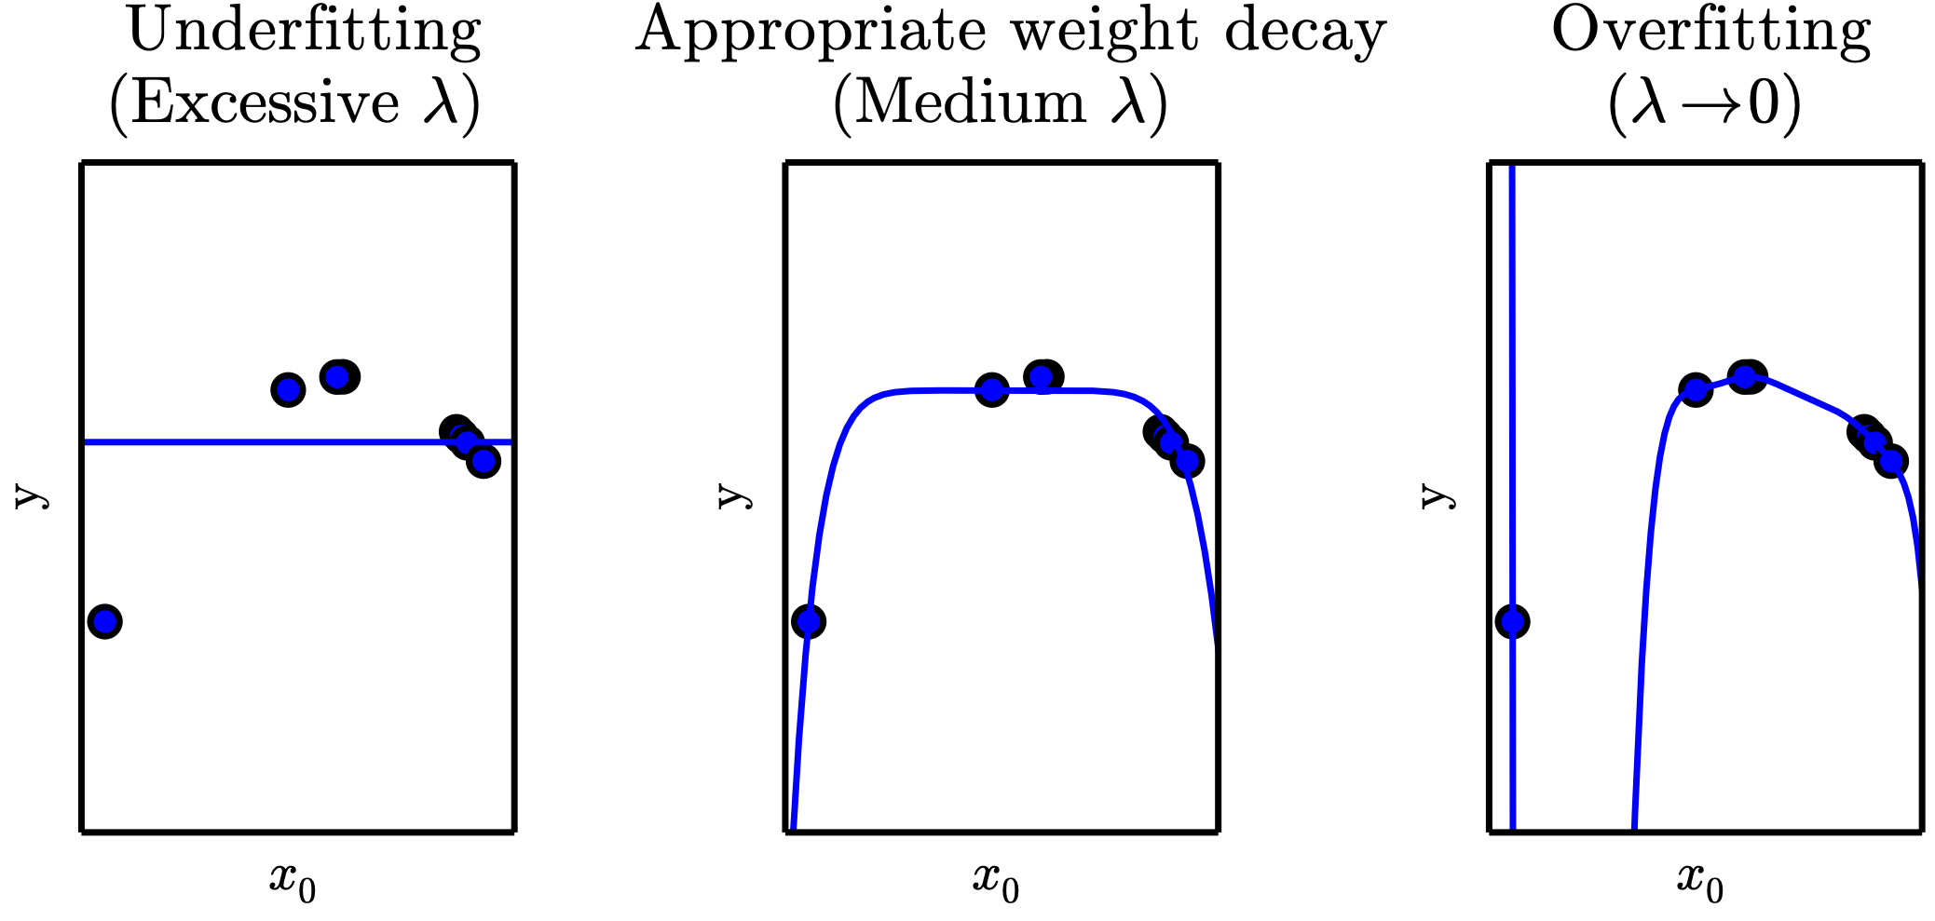
Weight Decay
Figure 5.5

Slide 55
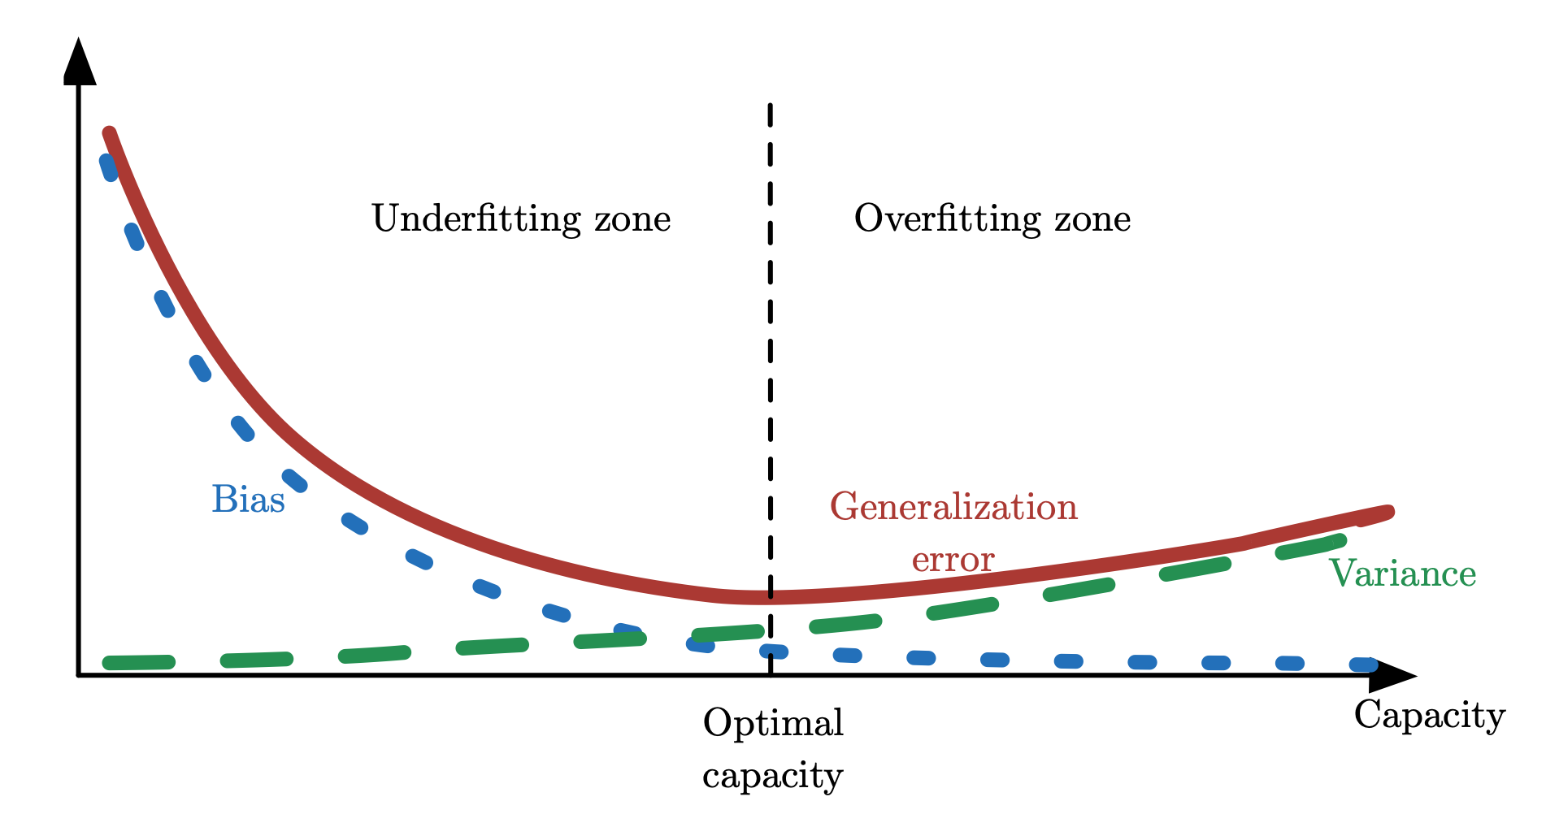
Bias and Variance
Figure 5.6

